Slide 1

Green Pace
Security Policy Presentation
Developer: Andres Cruz

Slide 2

OVERVIEW: DEFENSE IN DEPTH
My Security policy introduces industry best practices by taking a defense in depth approach to planning.

Slide 3
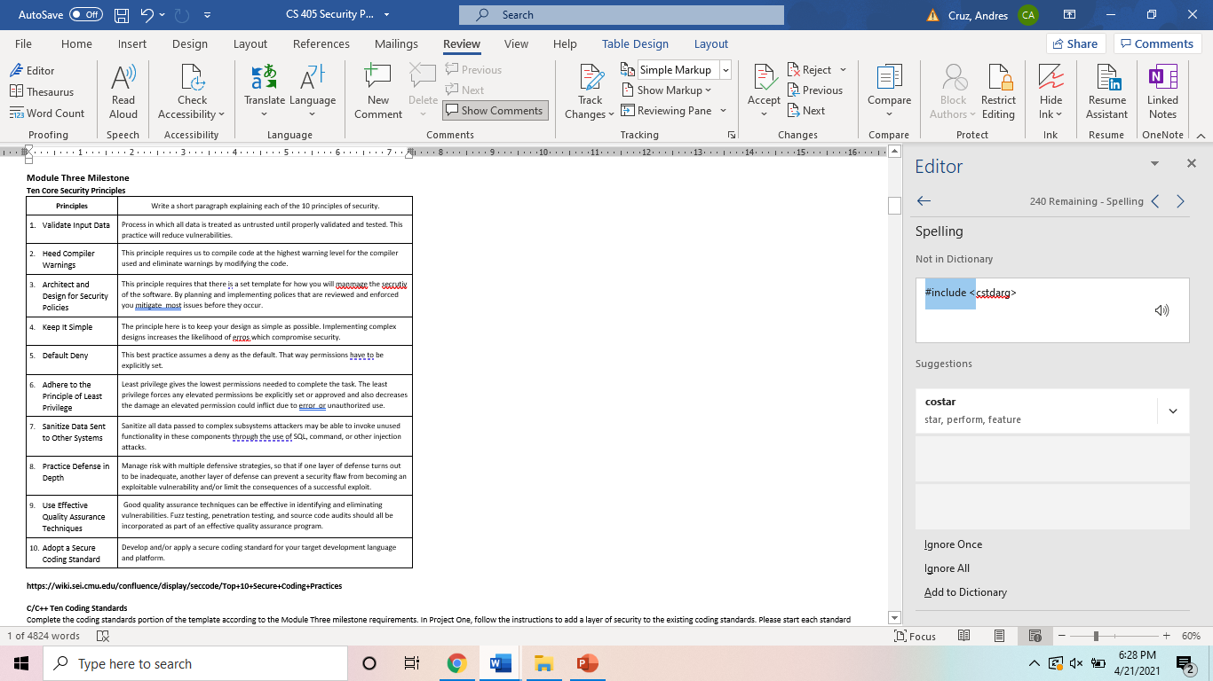
10 PRINCIPLES
Declarations and Initialization
Expressions
Intergers
Containers
Memory Protection
Character and strings
Exceptions
Object oriented Programming
Concurrency
Input Output

Slide 4
CODING STANDARDS
Declarations and Initialization
Expressions
Intergers
Containers
Memory Protection
Character and strings
Exceptions
Object oriented Programming
Concurrency
Input Output

Slide 5
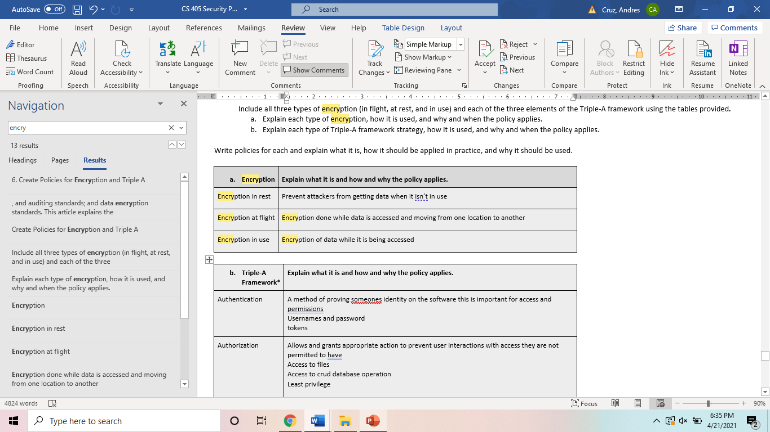
ENCRYPTION POLICIES

Slide 6
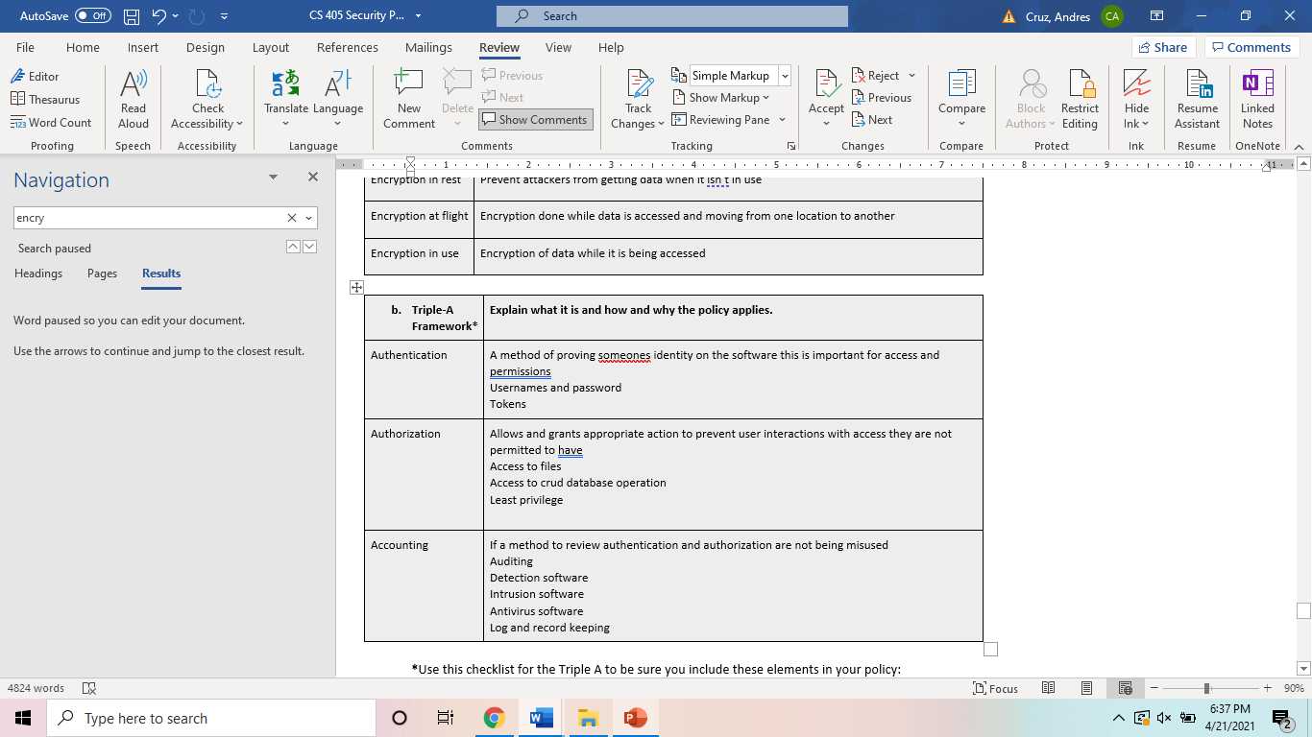
TRIPLE-A POLICIES

Slide 7
Unit Testing
// Uncomment the next line to use precompiled headers
#include "pch.h"
// uncomment the next line if you do not use precompiled headers
#include "gtest/gtest.h"
//the global test environment setup and tear down
// you should not need to change anything here
class Environment : public ::testing::Environment
{

Slide 8
Unit Testing
public:
~Environment() override {}
// Override this to define how to set up the environment.
void SetUp() override
{
// initialize random seed
srand(time(nullptr));
}

Slide 9
Unit Testing
// Override this to define how to tear down the environment.
void TearDown() override {}
};
// create our test class to house shared data between tests
// you should not need to change anything here
class CollectionTest : public ::testing::Test
{
protected:
// create a smart point to hold our collection
std::unique_ptr<std::vector<int>> collection;
void SetUp() override
{ // create a new collection to be used in the test
collection.reset(new std::vector<int>);
}
void TearDown() override
{ // erase all elements in the collection, if any remain
collection->clear();
// free the pointer
collection.reset(nullptr);
}
// helper function to add random values from 0 to 99 count times to the collection
void add_entries(int count)
{
assert(count > 0);
for (auto i = 0; i < count; ++i)
collection->push_back(rand() % 100);
}
};
// When should you use the EXPECT_xxx or ASSERT_xxx macros?
// Use ASSERT when failure should terminate processing, such as the reason for the test case.
// Use EXPECT when failure should notify, but processing should continue
// Test that a collection is empty when created.
// Prior to calling this (and all other TEST_F defined methods),
// CollectionTest::StartUp is called.

Slide 10
Unit Testing
// Following this method (and all other TEST_F defined methods),
// CollectionTest::TearDown is called
TEST_F(CollectionTest, CollectionSmartPointerIsNotNull)
{
// is the collection created
ASSERT_TRUE(collection);
// if empty, the size must be 0
ASSERT_NE(collection.get(), nullptr);
}
// Test that a collection is empty when created.
TEST_F(CollectionTest, IsEmptyOnCreate)
{
// is the collection empty?
ASSERT_TRUE(collection->empty());
// if empty, the size must be 0
ASSERT_EQ(collection->size(), 0);
}

Slide 11
Unit Testing
/* Comment this test out to prevent the test from running
* Uncomment this test to see a failure in the test explorer */
TEST_F(CollectionTest, AlwaysFail)
{
FAIL();
}
// TODO: Create a test to verify adding a single value to an empty collection
TEST_F(CollectionTest, CanAddToEmptyVector)

Slide 12
Unit Testing
{
// is the collection empty?
// if empty, the size must be 0
add_entries(1);
ASSERT_EQ(collection->size(), 1);
// is the collection still empty?
// if not empty, what must the size be?
}

Slide 13
Unit Testing
{
int capacity = 1;
int res = 0;
int res_expected = 1;
res=
}
// TODO: Create a test to verify the std::out_of_range exception is thrown when calling at() with an index out of bounds
// NOTE: This is a negative test
//DoesThrowWhenOutOfRangeWhenOutOfBounds
TEST(CollectionTest, out_of_range)

Slide 14
Unit Testing
{
try {
negative(12);
FAIL() << "Expected std::out_of_range";
}
catch (std::out_of_range const& err) {
EXPECT_EQ(err.what(), std::string("Out of range"));
}
catch (...) {

Slide 15
Unit Testing
FAIL() << "Expected std::out_of_range";
}
}
// TODO: Create 2 unit tests of your own to test something on the collection - do 1 positive & 1 negative
TEST_F(CollectionTest, TestPositive) {
EXPECT_EQ(1, 1);
}
TEST_F(CollectionTest, TestNegative) {
ASSERT_EQ(collection, -1);

Slide 16
Unit Testing
}
int main(int ac, char* av[])
{
testing::InitGoogleTest(&ac, av);
return RUN_ALL_TESTS();
}

Slide 17

AUTOMATION SUMMARY

Slide 18
TOOLS
DevSecOps pipeline outlines the stages where security is implemented and reviewed throughout the planning of an indpth defense system.
Software tests can be run against the system to automatically check for vulnerabilities and errors before advancing to the next stge. In addition to automated checks, individuals will also perform peer code reviews, this gives a second pair of eyes an opportunity to review for errors.
Finally a system of checks and balances is implemented utilizing software tools made to detect and prevent issues, HIDS and HIPS. This information is logged and ultimately reviewed by a security auditor that verifies that no threats exist.

Slide 19
RISKS AND BENEFITS
Depending on the risk and the measure put in place the effects can be very different. All risks should be reasonably mitigated although there will always be a level of risk that you accept. The risks you accept, typically have a low severity, probability, or a low remediation cost. It isn’t possible to mitigate all risks as the cost to do so would outweigh the benefit of the mitigation.

Slide 20
RECOMMENDATIONS
The largest gap exists in human error. The auditor has to understand the software HIDS and HIPS in order to effectively mitigate risks. Additionally, the auditor must not get complacent.

Slide 21
CONCLUSIONS
In the future the company should always look at patching and updating the system regularly. They should also stay current with new security options as software implementations can be exploited or become obsolete.

Slide 22
REFERENCES
https://wiki.sei.cmu.edu/confluence/pages/viewpage.action?pageId=88046322

